Slide 1
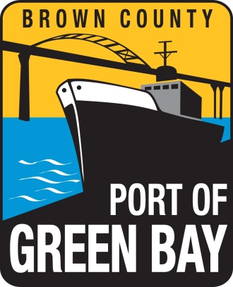

Cat Island Chain Restoration Project
Brown County Port & Solid Waste Department

Slide 2
Project Beginning
The Cat Island Chain project developed out of the 1988 Lower Green Bay Remedial Action Plan (RAP) and was the top priority project for habitat restoration.
Members of the Citizens Advisory Committee and DNR staff
worked together to develop the Lower Green Bay Remedial
Action Plan. (Photo by Dave Crehore)

Slide 3
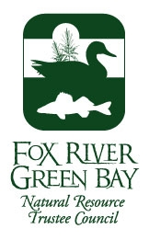









Current Project
Today the project’s primary focus continues to be habitat restoration and now has added the beneficial reuse of dredge material as a means of accomplishing the project.
The project is a partnership between Brown County, WDNR, WDOT, US Fish and Wildlife Service, US Army Corps of Engineers, USEPA UW-Sea Grant, UW-Green Bay, Port Operators and the Fox River Group of paper mills

Slide 4
Project Timeline
Planning and approvals
Dredged Material Management Plan – Fall 2009
Project Partnership Agreement – Summer 2012
Plans and Specifications – Summer 2012
Spine Construction
Phase 1 – Brown County GLRI EPA Grant – Access Road and Wave Barrier - Summer 2012
Phase 2 – US Army Corps GLRI Funding – Wave Barrier and Island Sides - Fall 2012 to Winter 2014
Phase 3 – US Army Corps – Filling of Island – 20-30 Years

Slide 5
Project Outcomes
30-50 years worth of disposal capacity
Beneficial reuse of dredged material
2.5 mile wave barrier and re-establishment of 272 acres of islands
Wave barrier will protect 1,400 acres and provide critical habitat for birds, fish and mammals
Sustain jobs, industries and economic outputs of the Port of Green Bay for NE Wisconsin

Slide 6
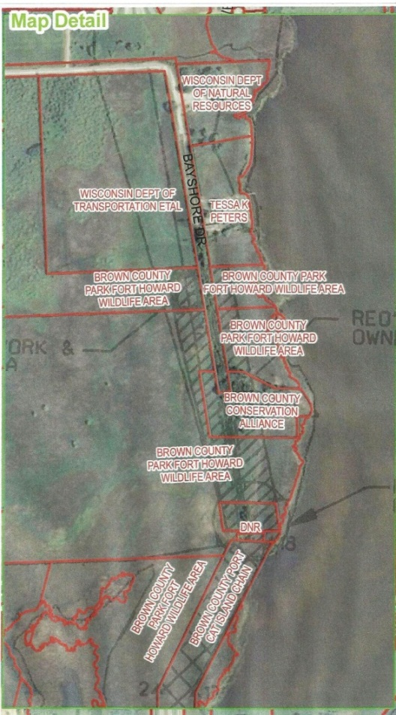
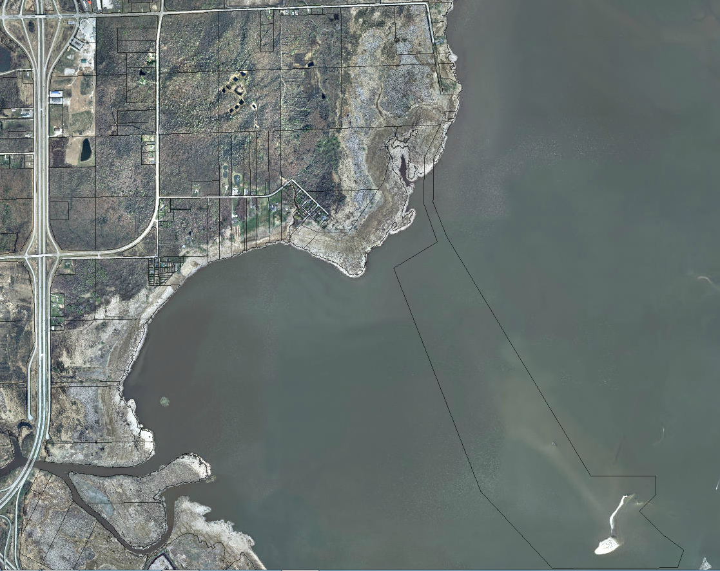
See Map Detail

Slide 7
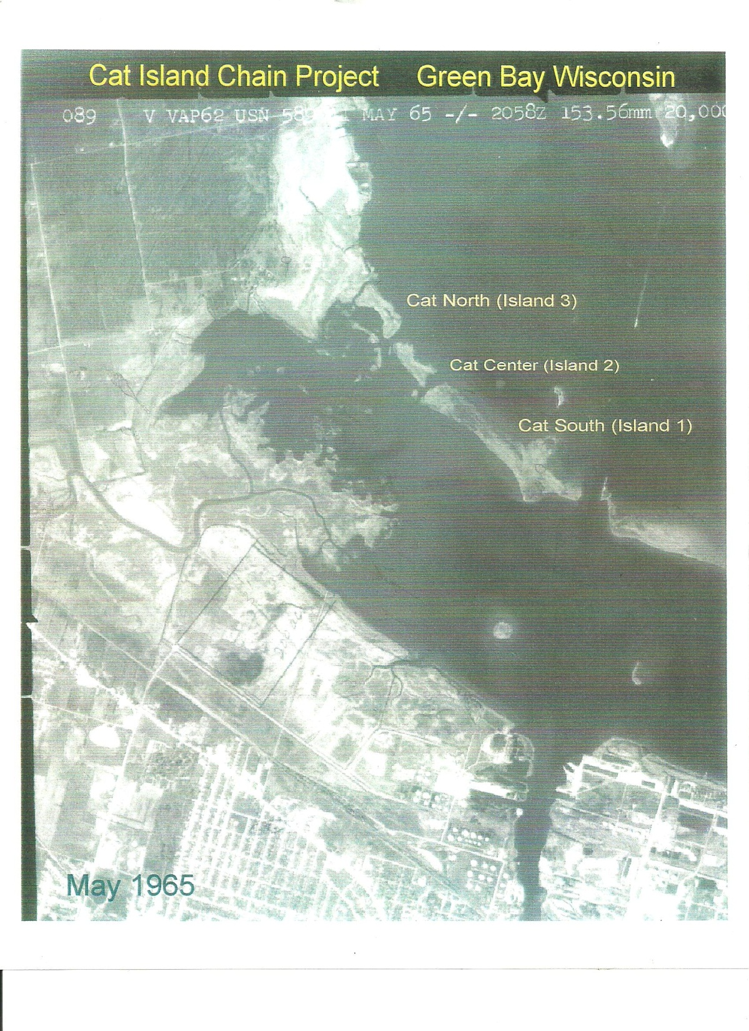
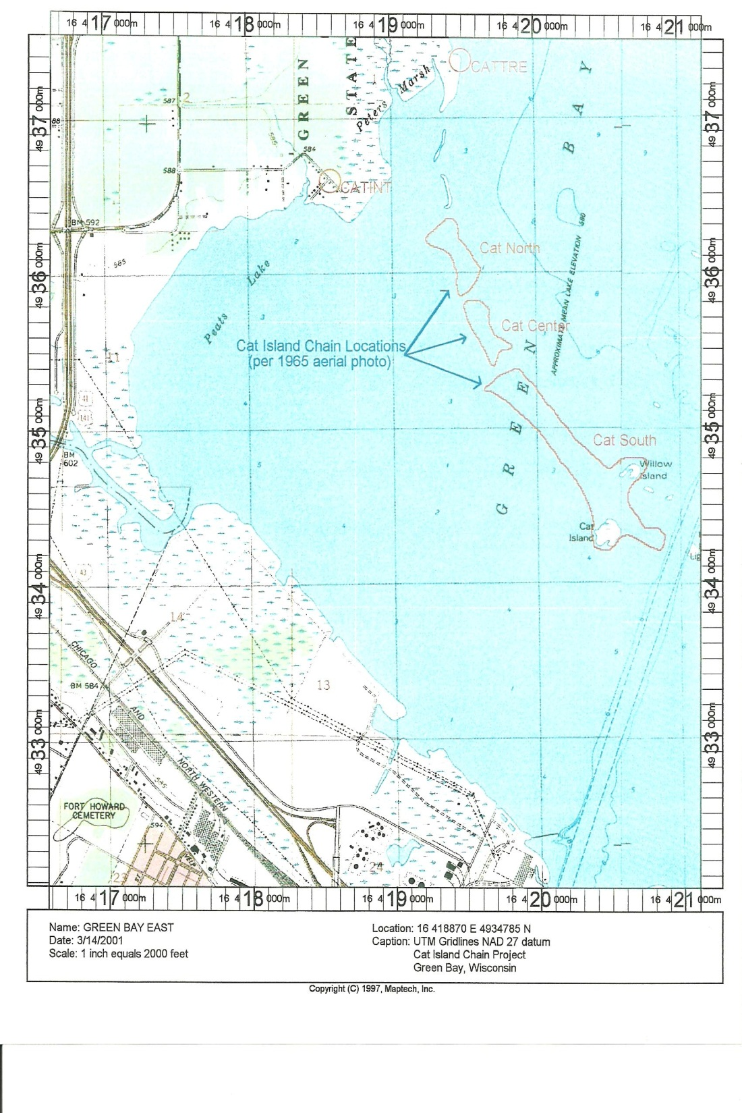


Slide 8
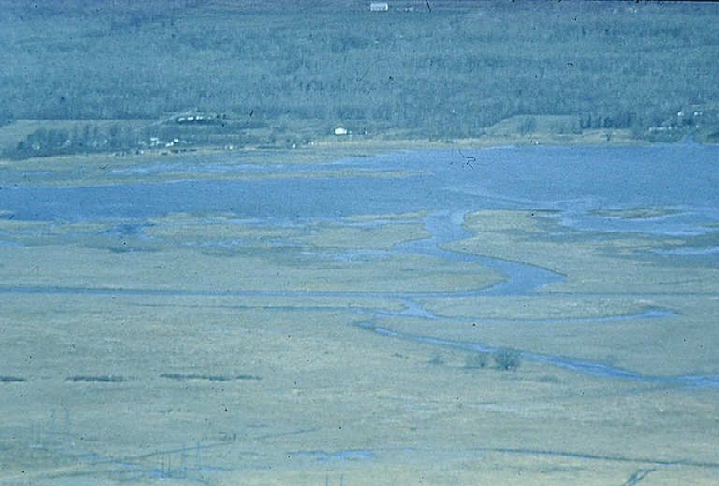
Historic Western view of lower Green Bay
Expansive emergent marshes (e.g. Duck Creek delta)
Numerous small islands
Beaches and mud flats
Submerged aquatic plant beds
Photo Courtesy of Tom Erdman , 1966

Slide 9
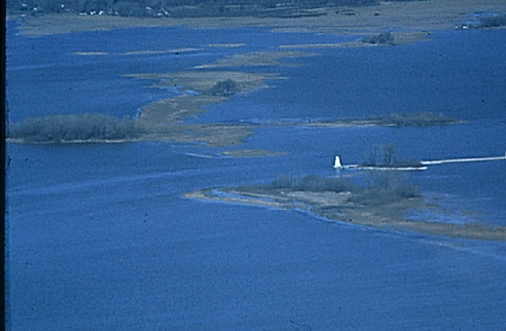
Bass Islands
Willow Island
Cat Island
Lone Tree Island
Navigation Channel
Grassy Island
1966 during low water levels
Islands extend 2.5 miles into Green Bay
Photo Courtesy of Tom Erdman , 1966
Notes:
The delta and other coastal wetlands were once protected by a group of small islands, also known as the Cat Island chain.
The islands reduced wind and wave fetch and dampened wave energy, reducing turbidity from sediment resuspension and damage to aquatic vegetation in southwest Green Bay.
The islands may be the remnant of an earlier shoreline for the south shore of the Bay, and were first impacted by dredging a navigation channel through the chain more than 100 years ago.

Slide 10
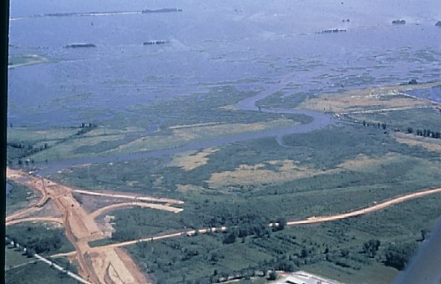
Long Tail Point
Cat Island
Bass Islands
Duck Creek Delta Marsh
Landfill
90% of Coastal Wetlands
Lost from Southern
Green Bay
I-43 Construction
Agriculture
Photo by WDNR, 1969
Notes:
The south shore coastal marshes were used by farmers during dry years.
Development has destroyed many wetlands parcel by parcel
Interstate highway construction
Pullium power plant construction and fly ash disposal
Oil storage tanks

Slide 11
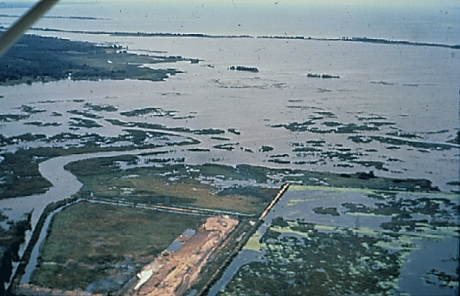
Little Tail Point
Long Tail Point
Peter’s Marsh
Cat Island Chain
Duck Creek Delta
Rock dikes hardened
the shoreline
Municipal incinerator
and landfill
Bayport Dredge Spoil Disposal
in Atkinson’s Marsh
Photo Courtesy of Tom Erdman , 1970
Notes:
Municipal incinerator and landfill
Dikes built to contain sediments dredged from the shipping channel hardened the shoreline
Rising water levels flooded the emergent wetlands beginning in the late 1960s and continuing until today.

Slide 12
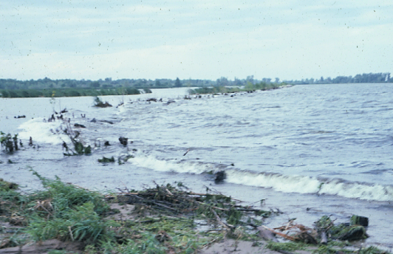
Rising Great Lakes water levels and severe storms
in 1970s caused wetland and island erosion
Notes:
As the islands eroded, the coastal marshes lost their protection from storm waves and ice breakup
Two severe spring storms in the early 1970s destroyed nearly all the islands and remaining coastal marshes.

Slide 13
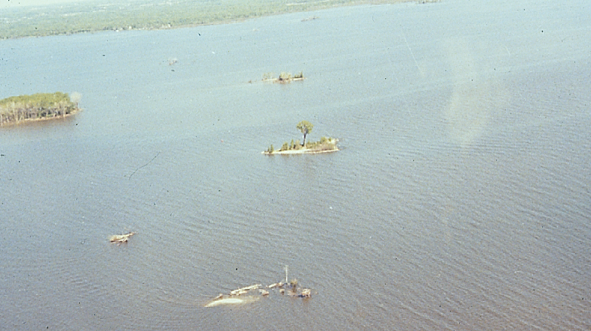
Willow Island
Cat Island
Lone Tree Island
Green Bay Islands during
high water levels in 1976
Grassy Island
Photo Courtesy of Tom Erdman , 1976
Notes:
Within ten years the islands and surrounding submerged aquatic plant beds and emergent marshes had nearly disappeared

Slide 14
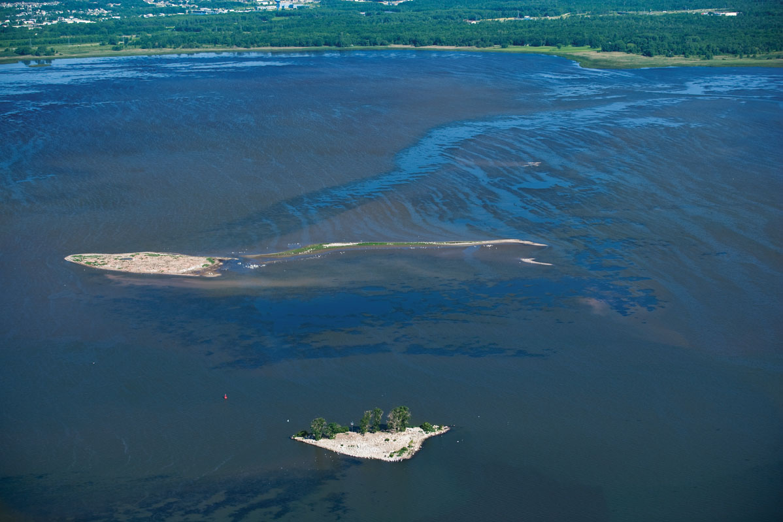
Brown County Aerial Photography , 2008

Slide 15
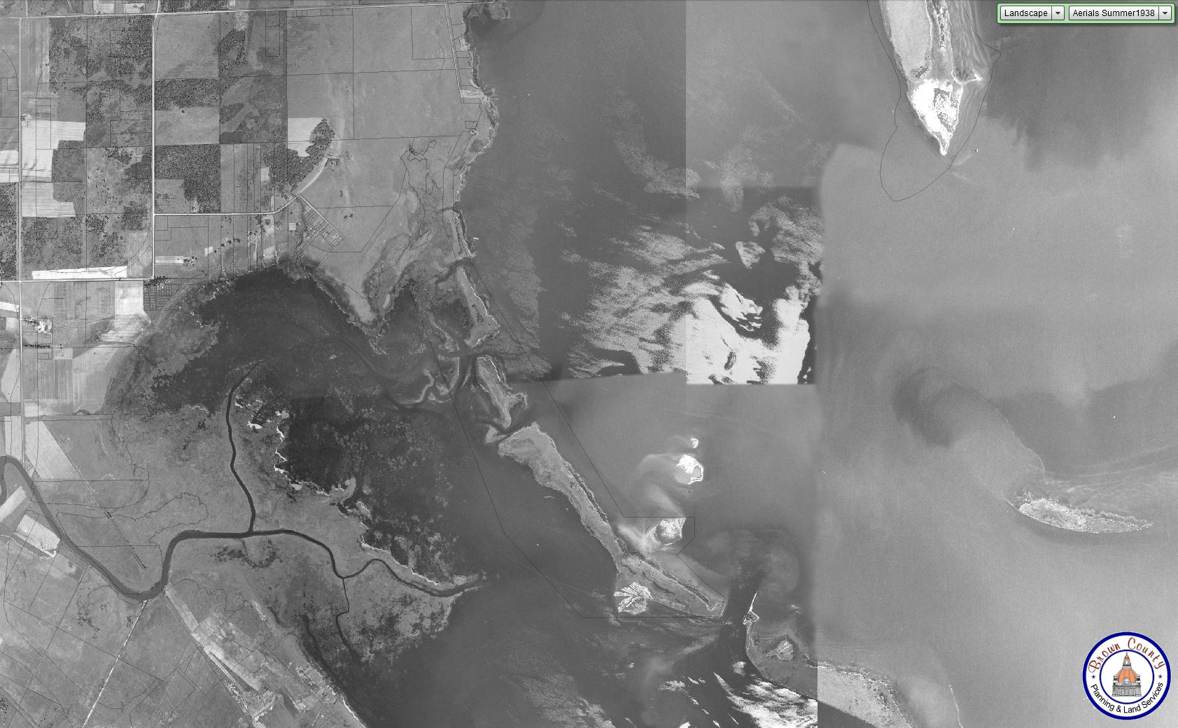
1938
Cat Island
Brown County Aerial Photography , 1938

Slide 16
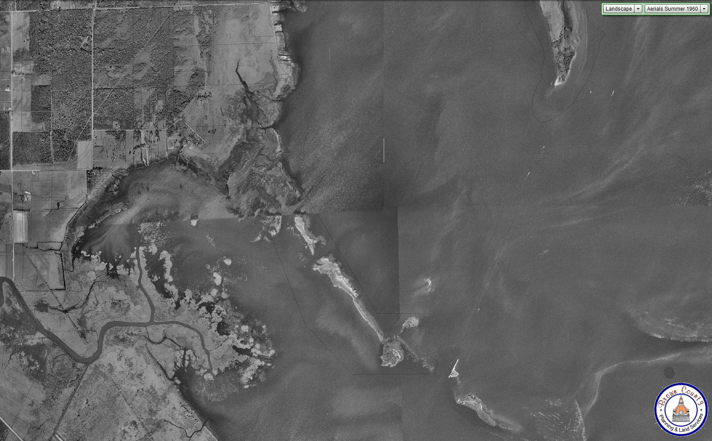
1960
Cat Island
Brown County Aerial Photography , 1960

Slide 17
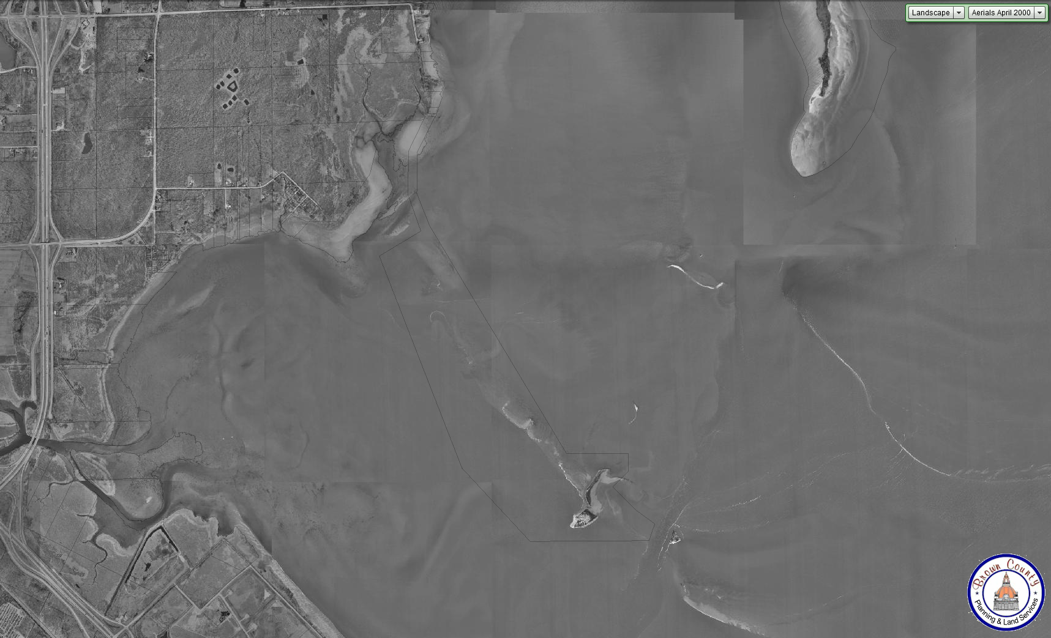
2000
Cat Island
Brown County Aerial Photography , 2000

Slide 18
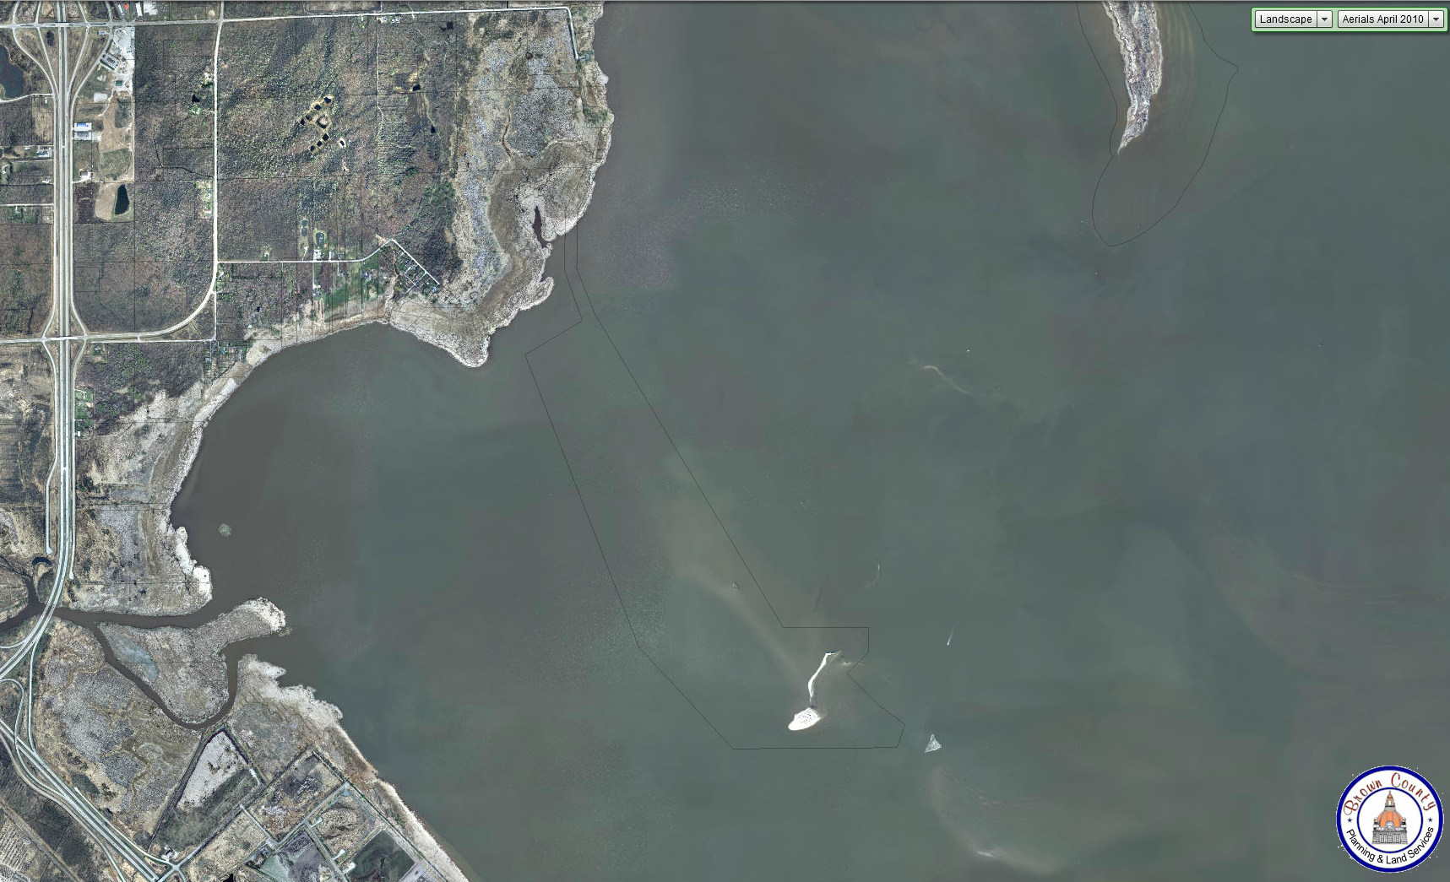
2010
Cat Island
Brown County Aerial Photography , 2010

Slide 19
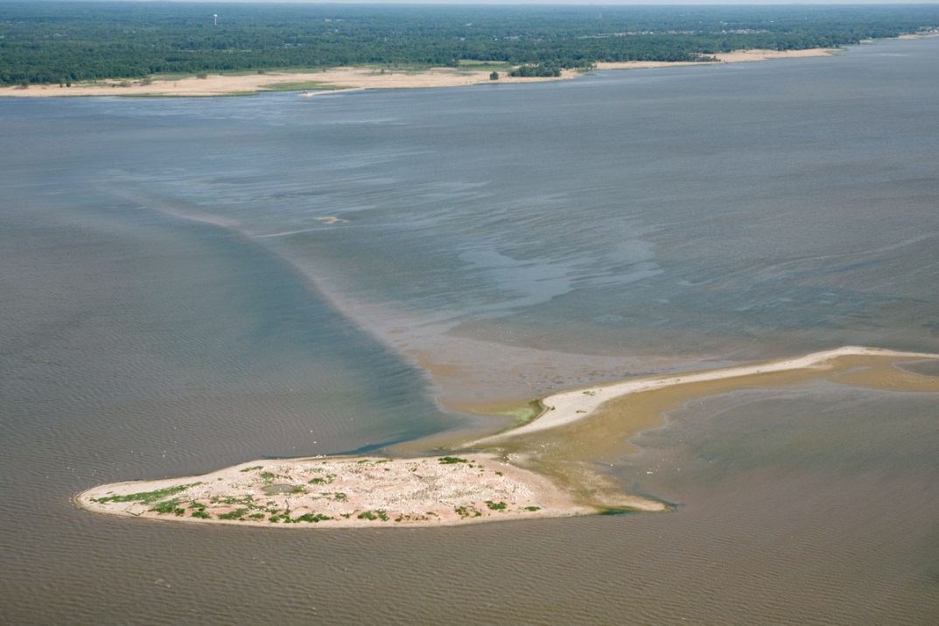
Current Conditions
Cat Island
Brown County Aerial Photography , 2012

Slide 20
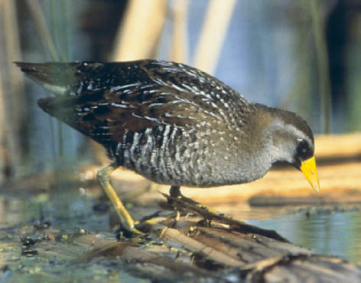
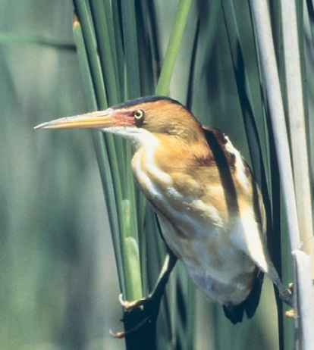
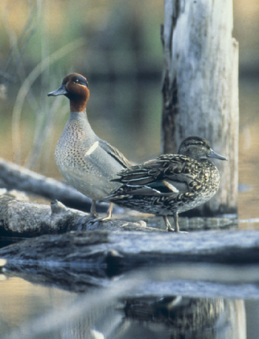
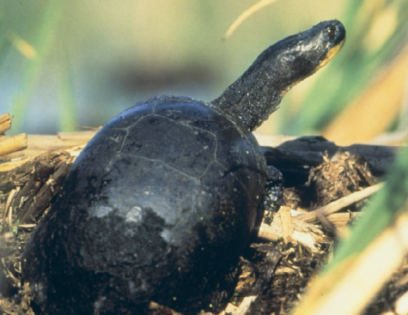
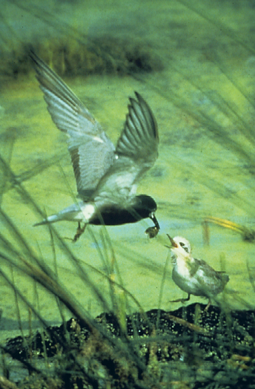
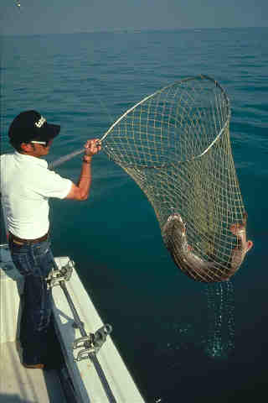
Lost habitat affects
Colonial Nesting Water Birds
Shorebirds
Waterfowl
Fish Spawning
Fish Nurseries
Turtles
Amphibians
Invertebrates

Slide 21
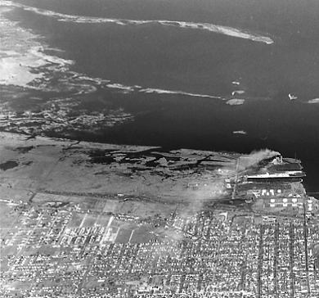
Fisheries Benefits from Recreation of Cat Island Chain
Increased Vegetation
  Nursery habitat
  Habitat for sunfish spp.
  Spawning habitat
Increased Water Clarity
  Predation by visual predators

Slide 22
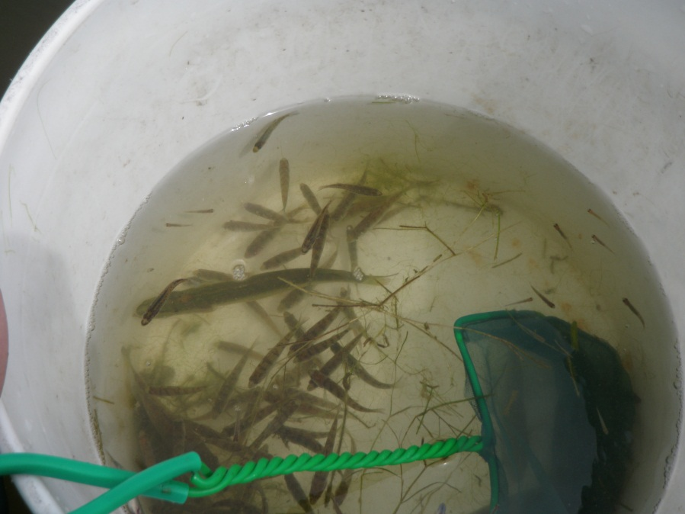
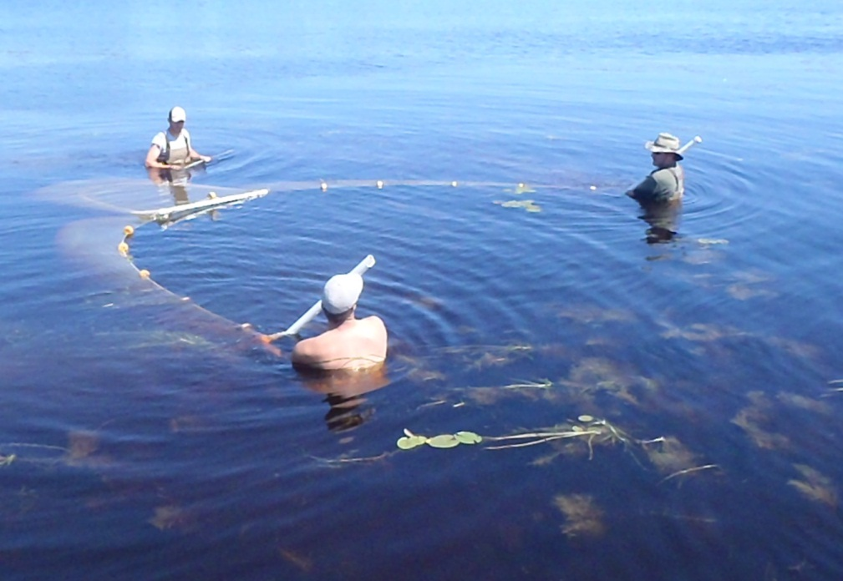
Improved Nursery Habitat
Fish species which rely on structure to hide juvenile fish will benefit from the increase in aquatic vegetation.

Slide 23
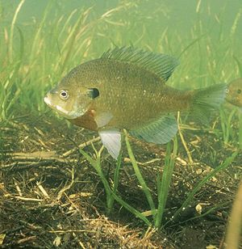
Sunfish Species
Sunfish Species; bluegill, largemouth bass, pumpkinseed
Feeding shift
  Insectivore → planktivore
  Insectivore → piscivore
Adapted to forage in vegetation during insectivore phase

Slide 24
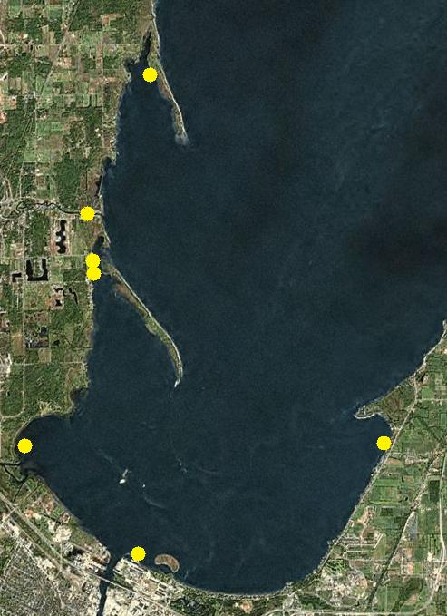
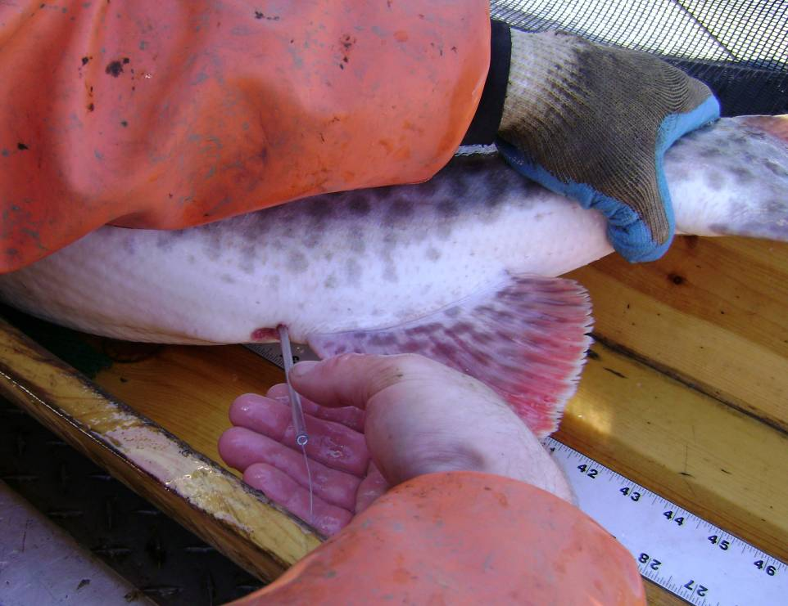
Muskellunge Spawning Habitat

Slide 25
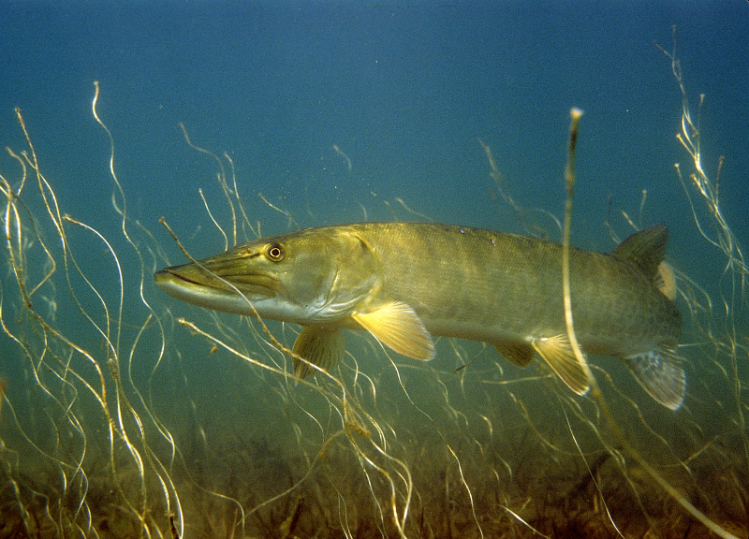
Improved Predation
Visual predators
  Increased efficiency
Reduced recruitment of Common Carp
Reduction in
  Bullheads
  Gizzard Shad
Photo from E. Engbretson

Slide 26
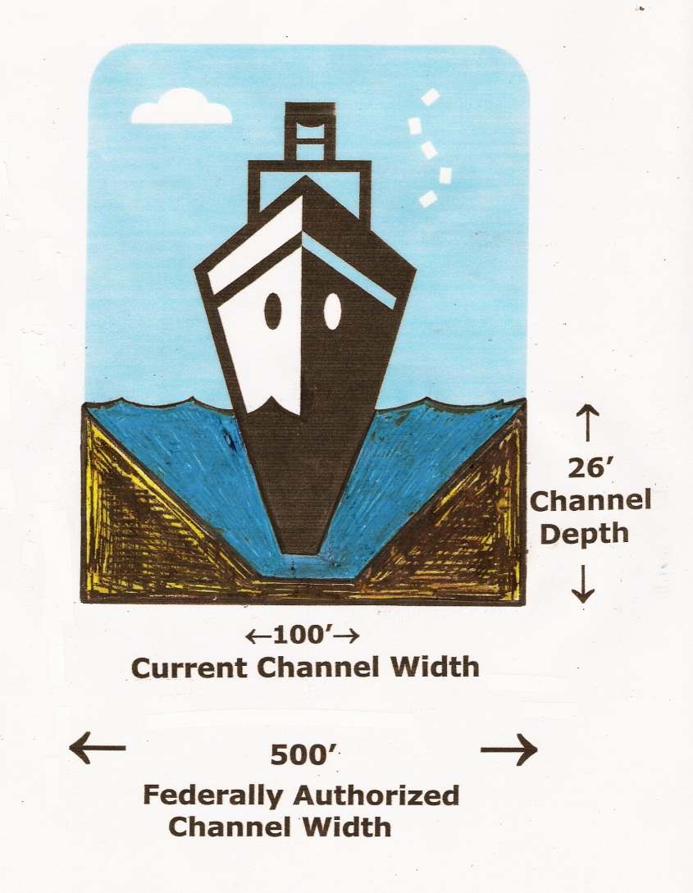
Annual Dredging
In order to maintain an active Port annual maintenance dredging is necessary
Annual dredging of 100,000 to 250,000 cy of sediment that has settled into the 14 mile long navigational channel

Slide 27
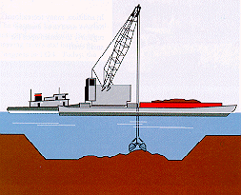
Dredging
Difference between Navigational Dredging and Environmental Dredging
Different types of navigational dredge material from different river reaches

Slide 28
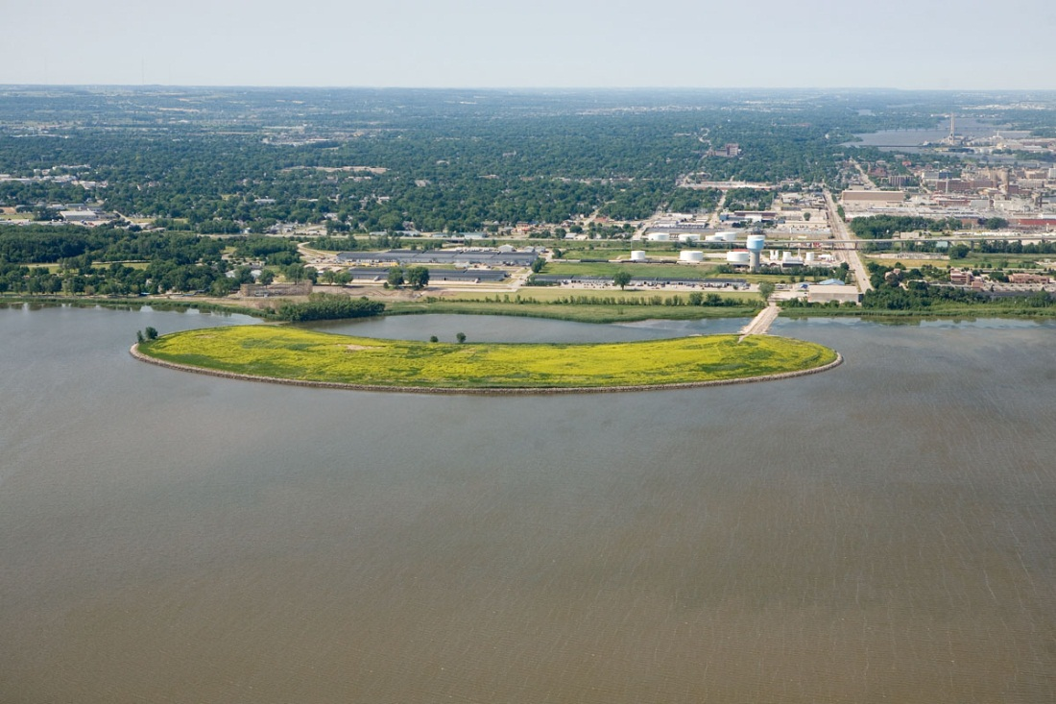
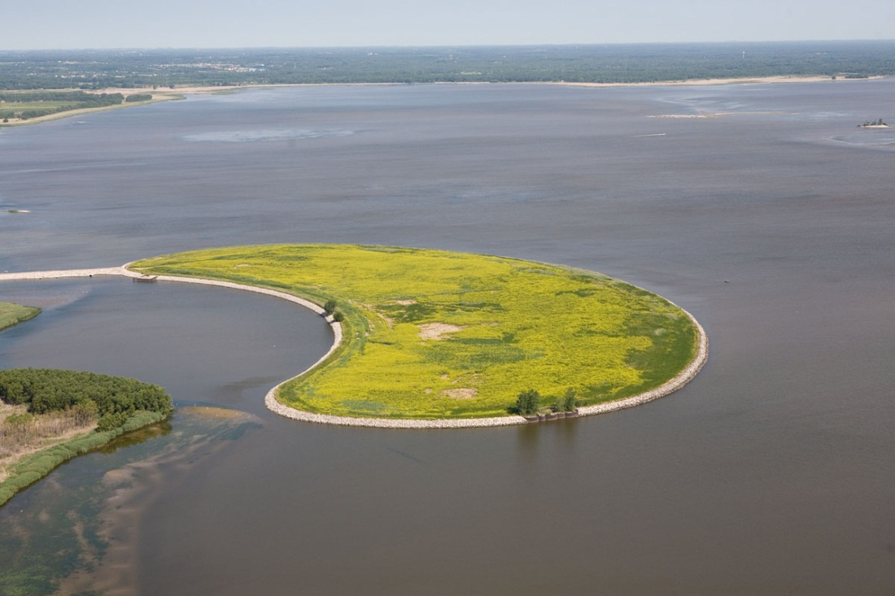
What to do with the Dredged Material?
Historical Disposal Options included:
Open water dumping
In-water Confined Disposal Facilities (CDF)
  Renard Island

Slide 29
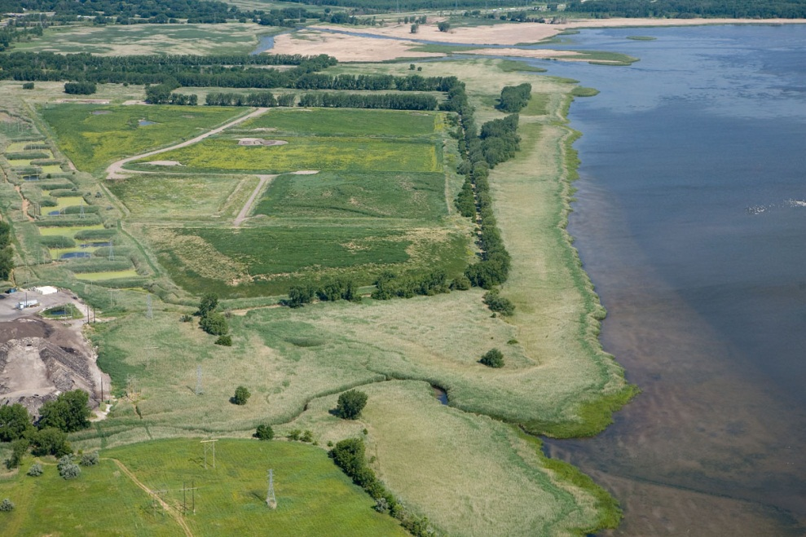
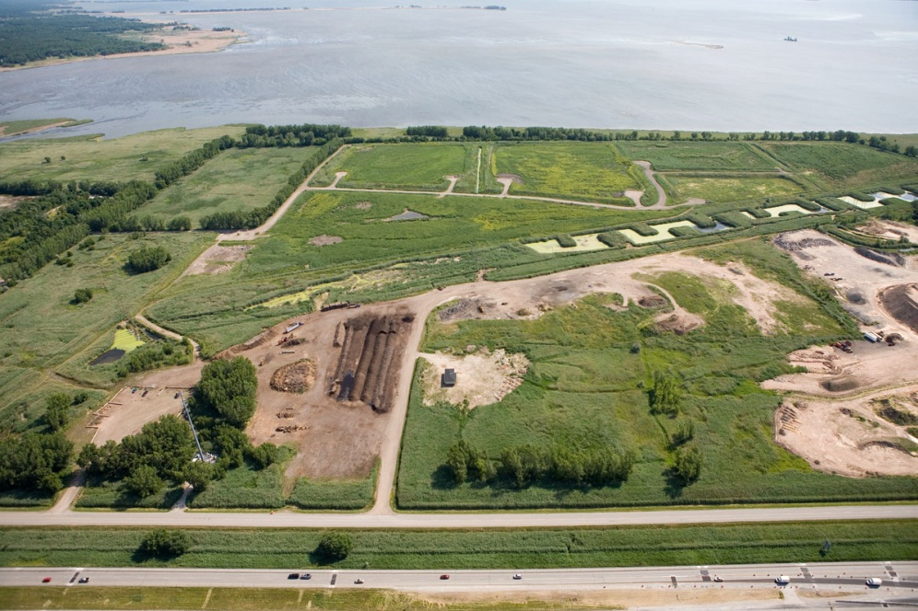
Disposal
Current Disposal Options include:
Upland CDF and beneficial reuse projects
  Bayport CDF
  Cat Island Chain Restoration Project
BayPort CDF

Slide 31
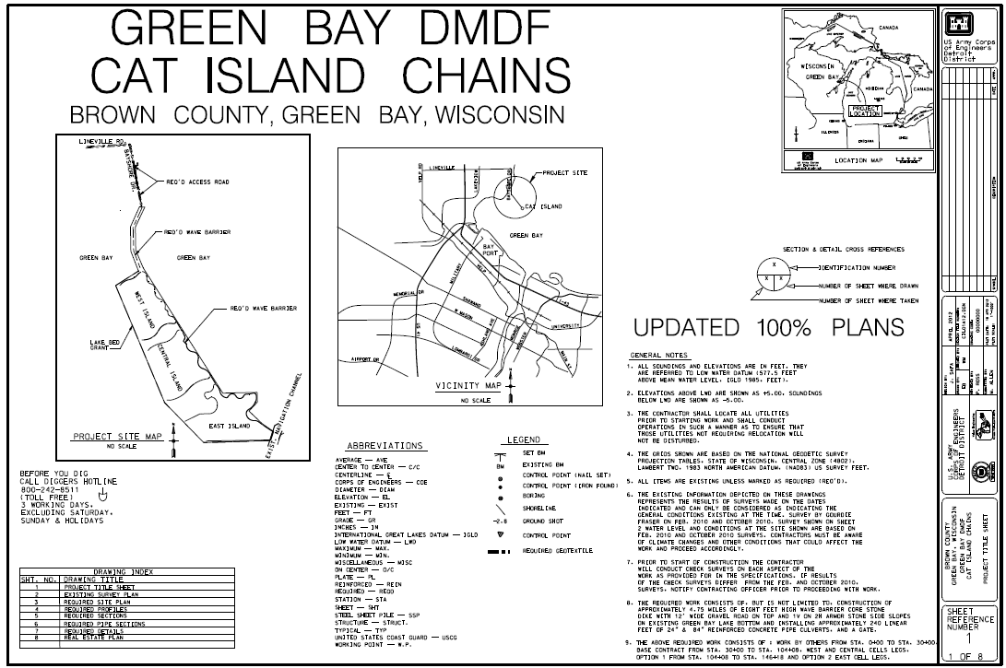

Slide 32
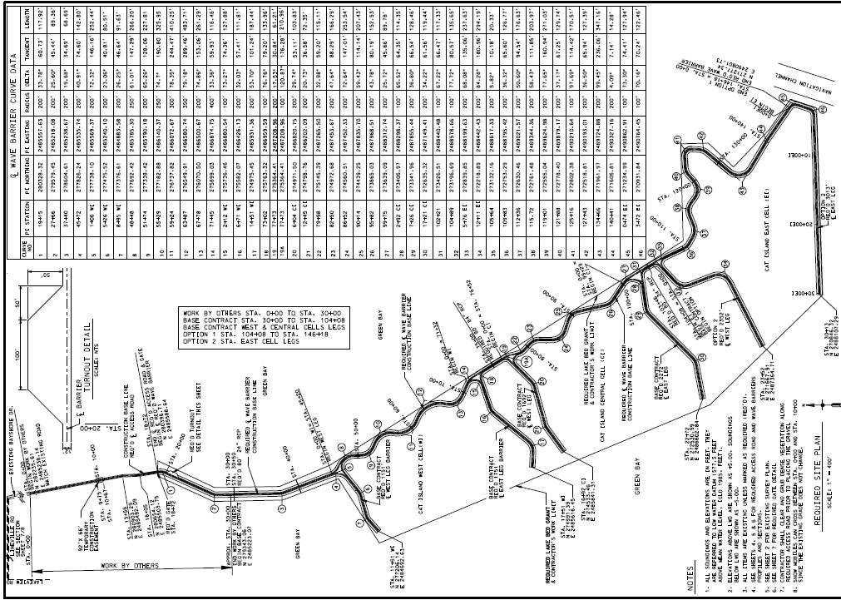

Slide 33
Disposal Capacity
Island | Area (acres) | Storage Capacity (yards³)
West Island | 74 | 630,000
Central Island | 92 | 720,000
East Island | 106 | 1,000,000
Only outer harbor “clean sediments” will be placed onto the islands
Spine of islands will be initially constructed and provide immediate wave protection and environmental benefits

Slide 34
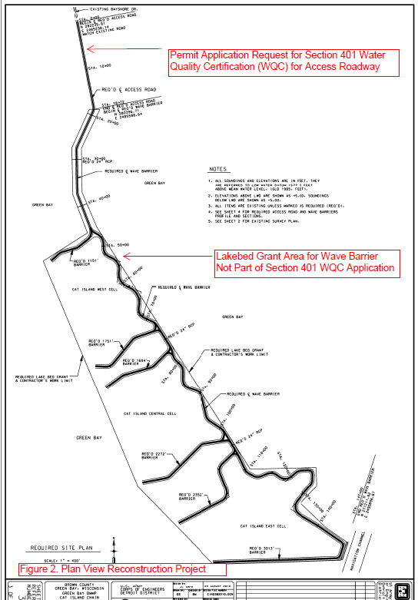

Slide 35
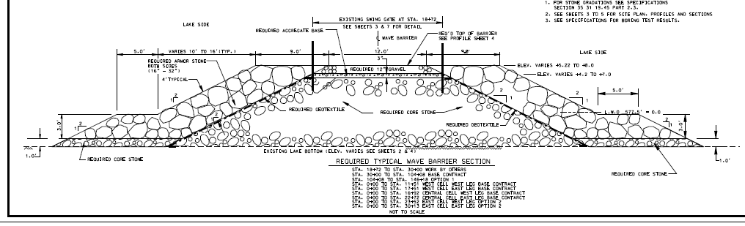
Wave Barrier Cross Section

Slide 36
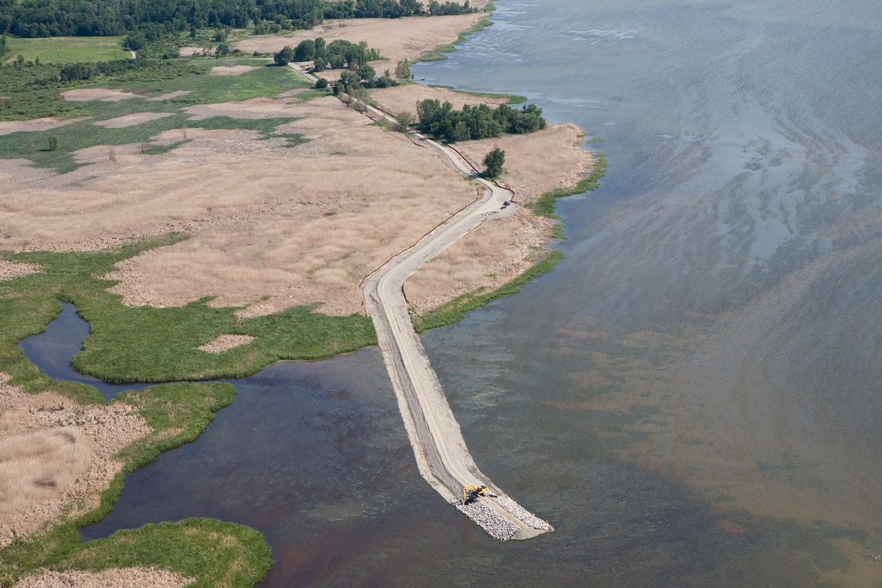

Slide 37
Project Costs
Project Cost $34,190,889
Less GLRI Grant $ 1,500,000
Total Project Costs $32,690,889
65% Federal Share $21,249,077
35% Non-Federal Share $11,441,811
Total Project Costs $32,690,889
Non-Federal Funding Sources
WDOT Harbor Assistance Grant $7,141,835
NRDA Funds $ 800,000
Terminal Operator Harbor Fees $ 499,000
Brown County $ 336,459
Brown County In-Kind $ 150,000
Total Non-Federal Funds $8,927,294
27% Non-Federal Cash Contribution $8,927,294
Value of Lands, Easements $ 250,000
Total Non-Federal Contribution $9,177,294

Slide 38
Project Outcome
30-50 years worth of disposal capacity
Beneficial reuse of dredged material
2.5 mile wave barrier and re-establishment of 272 acres of islands
Wave barrier will protect 1,400 acres and provide critical habitat for birds, fish and mammals
Sustain jobs, industries and economic outputs of the Port of Green Bay for NE Wisconsin

Slide 39
Questions?

